Slide 1
SYMMETRIC KEY CRYPTO & Block Ciphers
Falguni Roy

Slide 2
Last Chapter
have considered:
  terminology
  classical cipher techniques
  substitution ciphers
    cryptanalysis using letter frequencies
  transposition ciphers

Slide 3
Modern Block Ciphers
Will now look at modern block ciphers
One of the most widely used types of cryptography algorithms
Provide strong secrecy and/or authentication services
In particular will introduce DES (data encryption standard)
Notes:
Modern block ciphers are widely used to provide encryption of quantities of information, and/or a cryptographic checksum to ensure the contents have not been altered. We continue to use block ciphers because they are comparatively fast, and because we know a fair amount about how to design them.

Slide 4
Block vs Stream Ciphers
Block ciphers process messages into blocks, each of which is then en/decrypted
Like a substitution on very big characters
  64-bits or more
Stream ciphers process messages a bit or byte at a time when en/decrypting
Many current ciphers are block ciphers
Hence are focus of course
Notes:
Block ciphers work a on block / word at a time, which is some number of bits. All of these bits have to be available before the block can be processed. Stream ciphers work on a bit or byte of the message at a time, hence process it as a “stream”.

Slide 5
Block Cipher Principles
Block ciphers look like an extremely large substitution
Would need table of 2⁶⁴ entries for a 64-bit block
Arbitrary reversible substitution cipher for a large block size is not practical
  64-bit general substitution block cipher, key size 2⁶⁴!
Most symmetric block ciphers are based on a feistel cipher structure
Needed since must be able to decrypt ciphertext to recover messages efficiently
Notes:
An arbitrary reversible substitution cipher for a large block size is not practical, however, from an implementation and performance point of view. In general, for an n-bit general substitution block cipher, the size of the key is n x 2^{n}. For a 64-bit block, which is a desirable length to thwart statistical attacks, the key size is 64 x 2⁶⁴ = 2⁷⁰ = 10²¹ bits.

Slide 6
C. Shannon and Substitution-Permutation Ciphers
In 1949 Shannon introduced idea of substitution-permutation (S-P) networks
  Modern substitution-transposition product cipher
These form the basis of modern block ciphers
S-P networks are based on the two primitive cryptographic operations we have seen before:
  Substitution (s-box)
  Permutation (p-box) (transposition)
Provide confusion and diffusion of message
Notes:
Claude Shannon’s 1949 paper has the key ideas that led to the development of modern block ciphers. Critically, it was the technique of layering groups of S-boxes separated by a larger P-box to form the S-P network, a complex form of a product cipher. He also introduced the ideas of confusion and diffusion, notionally provided by S-boxes and P-boxes (in conjunction with S-boxes).

Slide 7
Diffusion and Confusion
Introduced by Claude Shannon to thwart cryptanalysis based on statistical analysis
  confusion and diffusion are two properties of the operation of a secure cipher
  Assume the attacker has some knowledge of the statistical characteristics of the plaintext
Cipher needs to completely obscure statistical properties of original message
A one-time pad does this

Slide 8
Diffusion and Confusion
More practically shannon suggested combining elements to obtain:
Diffusion – dissipates statistical structure of plaintext over bulk of ciphertext
  Diffusion means that if we change a single bit of the plaintext, then (statistically) half of the bits in the ciphertext should change, and similarly, if we change one bit of the ciphertext, then approximately one half of the plaintext bits should change.
Confusion – makes relationship between ciphertext and key as complex as possible
  Confusion means that each binary digit (bit) of the ciphertext should depend on several parts of the key, obscuring the connections between the two
Notes:
Every block cipher involves a transformation of a block of plaintext into a block of ciphertext, where the transformation depends on the key. The mechanism of diffusion seeks to make the statistical relationship between the plaintext and ciphertext as complex as possible in order to thwart attempts to deduce the key. confusion seeks to make the relationship between the statistics of the ciphertext and the value of the encryption key as complex as possible, again to thwart attempts to discover the key.
So successful are diffusion and confusion in capturing the essence of the desired attributes of a block cipher that they have become the cornerstone of modern block cipher design.

Slide 9
Feistel Cipher Structure
Horst Feistel devised the feistel cipher
  Implements shannon’s substitution-permutation network concept
Partitions input block into two halves
  Process through multiple rounds which
  Perform a substitution on left data half
  Based on round function of right half & subkey
  Then have permutation swapping halves
Notes:
Horst Feistel, working at IBM Thomas J Watson Research Labs devised a suitable invertible cipher structure in early 70's.
One of Feistel's main contributions was the invention of a suitable structure which adapted Shannon's S-P network in an easily inverted structure. Essentially the same h/w or s/w is used for both encryption and decryption, with just a slight change in how the keys are used. One layer of S-boxes and the following P-box are used to form the round function.

Slide 10
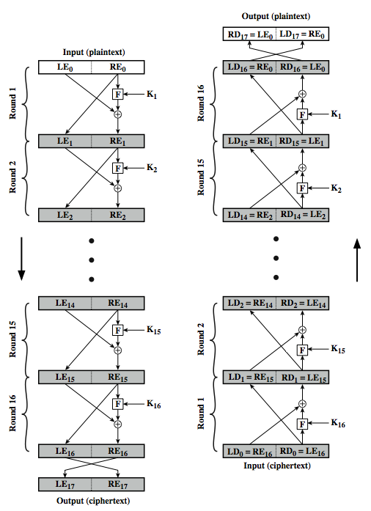

Feistel Cipher Structure

Slide 11
Feistel Cipher
N sequential rounds
A substitution on the left half l_{i}
  Apply a round function F to the right half r_{i} and
  Take XOR of the output of (1) and l_{i}
The round function is parameterized by the subkey k_{i}
  K_{i} are derived from the overall key K

Slide 12
Feistel Cipher Design Principles
Block size
  Increasing size improves security, but slows cipher
Key size
  Increasing size improves security, makes exhaustive key searching harder, but may slow cipher
Number of rounds
  Increasing number improves security, but slows cipher
Subkey generation
  Greater complexity can make analysis harder, but slows cipher
Round function
  Greater complexity can make analysis harder, but slows cipher
Fast software en/decryption & ease of analysis
  Are more recent concerns for practical use and testing

Slide 13
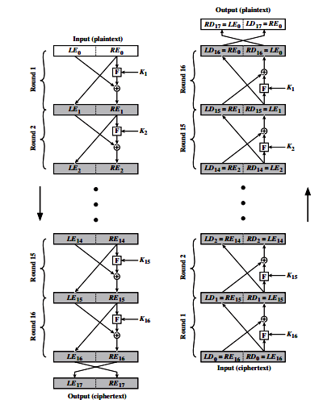
Feistel Cipher Decryption
Notes:
The process of decryption with a Feistel cipher is essentially the same as the encryption process. The rule is as follows: Use the ciphertext as input to the algorithm, but use the subkeys Ki in reverse order. That is, use Kn in the first round, Kn–1 in the second round, and so on until K1 is used in the last round. This is a nice feature because it means we need not implement two different algorithms, one for encryption and one for decryption.

Slide 14
Data Encryption Standard (DES)
Most widely used block cipher in world
Adopted in 1977 by NBS (now NIST)
DES is a Feistel cipher with 16 rounds;
DES has a 64-bit block length;
DES uses a 56-bit key;
Has widespread use

Slide 15
DES History
IBM developed lucifer cipher
  By team led by feistel
  Used 64-bit data blocks with 128-bit key
Then redeveloped as a commercial cipher with input from NSA and others
In 1973 NBS issued request for proposals for a national cipher standard
IBM submitted their revised lucifer which was eventually accepted as the DES

Slide 16
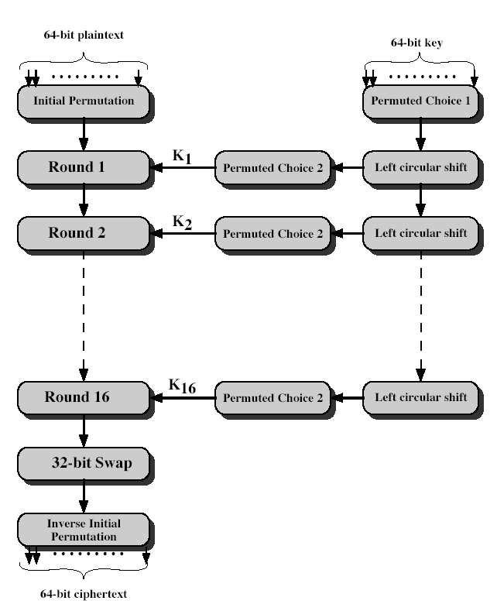
DES Encryption
Notes:
Stallings Fig 3-7.
The basic process in enciphering a 64-bit data block using the DES, shown on the left side, consists of:
- an initial permutation (IP)
- 16 rounds of a complex key dependent round function involving substitution and permutation functions
- a final permutation, being the inverse of IP
The right side shows the handling of the 56-bit key and consists of:
- an initial permutation of the key (PC1) which selects 56-bits in two 28-bit halves
- 16 stages to generate the subkeys using a left circular shift and a permutation

Slide 17
Required to specify DES
Round function
Key schedule
Any additional processing − Initial and final permutation

Slide 18
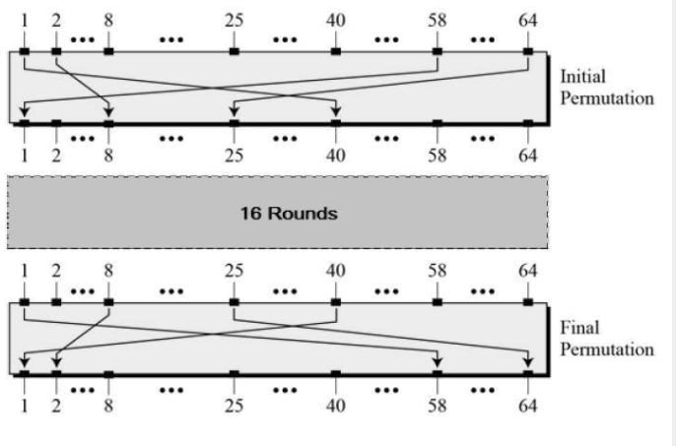
Initial and Final Permutation (IP & FP)
IP: first step of the data computation
IP reorders the input data bits
The initial and final permutations are straight Permutation boxes (P-boxes) that are inverses of each other.
They have no cryptography significance in DES.
Notes:
The initial permutation and its inverse are defined by tables, as shown in Tables 3.2a and 3.2b, respectively. The tables are to be interpreted as follows. The input to a table consists of 64 bits numbered from 1 to 64. The 64 entries in the permutation table contain a permutation of the numbers from 1 to 64. Each entry in the permutation table indicates the position of a numbered input bit in the output, which also consists of 64 bits.
Note that the bit numbering for DES reflects IBM mainframe practice, and is the opposite of what we now mostly use - so be careful! Numbers from Bit 1 (leftmost, most significant) to bit 32/48/64 etc (rightmost, least significant).
Note that examples are specified using hexadecimal.

Slide 19
DES Round Structure
Uses two 32-bit L & R halves
As for any feistel cipher can describe as:
  L_{i} = r_{i–1}
  R_{i} = l_{i–1} xor f(r_{i–1}, k_{i})
Takes 32-bit R half and 48-bit subkey and:
  Expands R to 48-bits using expansion permutation E (table 3.2 c.)
  Adds to subkey
  Passes through 8 s-boxes to get 32-bit result
  Finally permutes this using 32-bit permutation function P (table 3.2 d)
  s-boxes provide the “confusion” of data and key values whilst the permutation P then spreads this as widely as possible, so each S-box output affects as many S-box inputs in the next round as possible, giving “diffusion”.
Notes:
Note that the s-boxes provide the “confusion” of data and key values, whilst the permutation P then spreads this as widely as possible, so each S-box output affects as many S-box inputs in the next round as possible, giving “diffusion”.

Slide 20
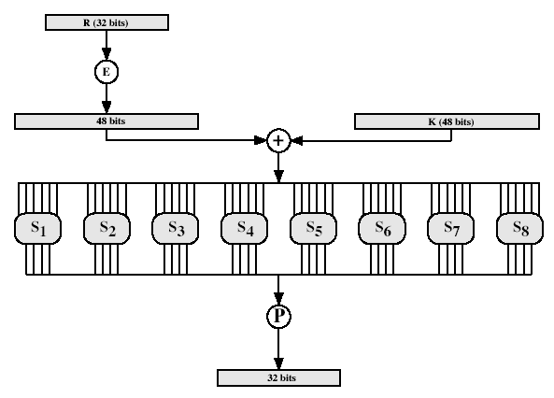
The round function F(R,K)
Notes:
Stallings Fig 3-9.

Slide 21
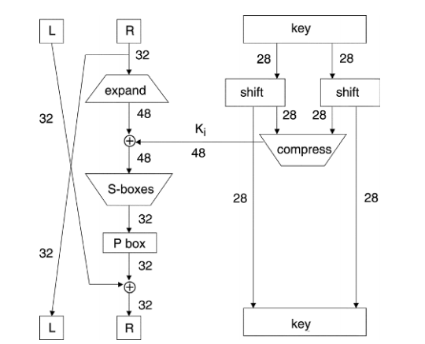
One round of DES

Slide 22
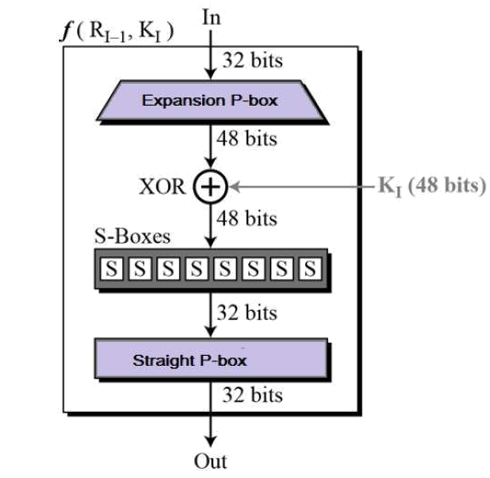

Slide 23
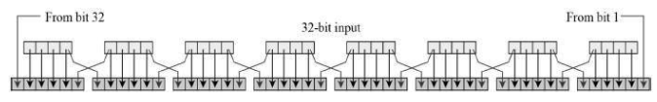
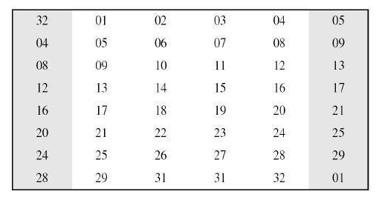
Expansion Permutation Box
Expansion Permutation Box − Since right input is 32-bit and round key is a 48-bit, we first need to expand right input to 48 bits.

Slide 24
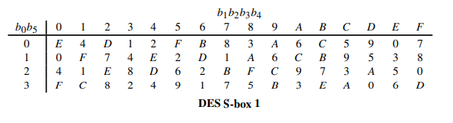
Substitution Boxes S
8 s-boxes (table 3.3 )
Each s-box maps 6 to 4 bits
  Outer bits 1 & 6 (row bits) select the row
  Inner bits 2-5 (col bits) select the column
  For example, in S1, for input 011001,
    The row is 01 (row 1)
    The column is 1100 (column 12).
    The value in row 1, column 12 is 9
    The output is 1001.
Result is 8 x 4 bits, or 32 bits
Notes:
The substitution consists of a set of eight S-boxes, each of which accepts 6 bits as input and produces 4 bits as output. These transformations are defined in Table 3.3, which is interpreted as follows: The first and last bits of the input to box Si form a 2-bit binary number to select one of four substitutions defined by the four rows in the table for Si. The middle four bits select one of the sixteen columns. The decimal value in the cell selected by the row and column is then converted to its 4-bit representation to produce the output. For example, in S1, for input 011001, the row is 01 (row 1) and the column is 1100 (column 12). The value in row 1, column 12 is 9, so the output is 1001.

Slide 25
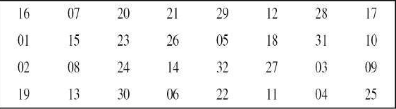
Straight Permutation
Straight Permutation − The 32 bit output of S-boxes is then subjected to the straight permutation with rule shown in the following illustration:

Slide 26
DES Key Schedule
Forms subkeys used in each round
Initial permutation of the key PC1 (table 3.4b)
Divide the 56-bits in two 28-bit halves
At each round
  Left shift each half (28bits) separately either 1 or 2 places based on the left shift schedule (table 3.4d)
      Shifted values will be input for next round
  Combine two halfs to 56 bits, permuting them by PC2 (table 3.4c) for use in function f
      PC2 takes 56-bit input, outputs 48 bits
Notes:
The 56 bit key size comes from security considerations as we know now. It was big enough so that an exhaustive key search was about as hard as the best direct attack (a form of differential cryptanalysis called a T-attack, known by the IBM & NSA researchers), but no bigger. The extra 8 bits were then used as parity (error detecting) bits, which makes sense given the original design use for hardware communications links. However we hit an incompatibility with simple s/w implementations since the top bit in each byte is 0 (since ASCII only uses 7 bits), but the DES key schedule throws away the bottom bit! A good implementation needs to be cleverer!
Details of these permutations and the key rotation schedule are given in text Table 3.4.

Slide 27
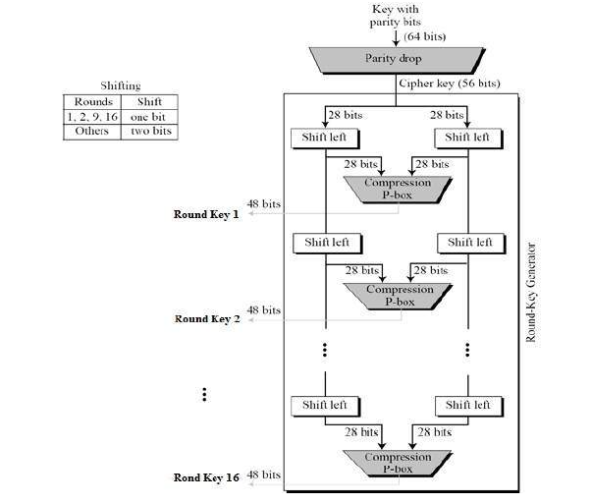

Slide 28
DES Decryption
Decrypt must unwind steps of data computation
With feistel design, do encryption steps again
Using subkeys in reverse order (SK16 … SK1)
Note that IP undoes final FP step of encryption
1st round with SK16 undoes 16th encrypt round
….
16th round with sk1 undoes 1st encrypt round
Then final fp undoes initial encryption ip
Thus recovering original data value

Slide 29
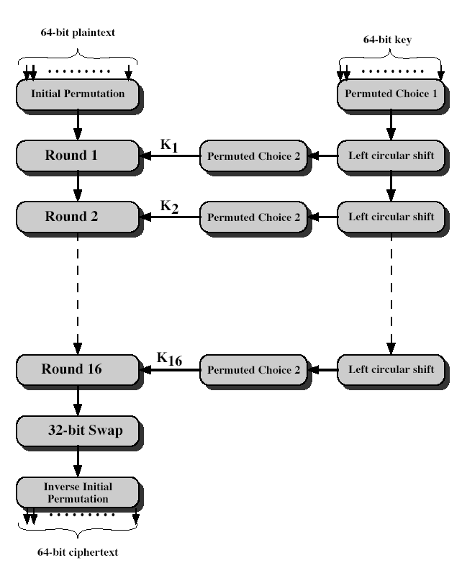
DES Decryption (reverse encryption)
Notes:
Stallings Fig 3-7.
The basic process in enciphering a 64-bit data block using the DES, shown on the left side, consists of:
- an initial permutation (IP)
- 16 rounds of a complex key dependent round function involving substitution and permutation functions
- a final permutation, being the inverse of IP
The right side shows the handling of the 56-bit key and consists of:
- an initial permutation of the key (PC1) which selects 56-bits in two 28-bit halves
- 16 stages to generate the subkeys using a left circular shift and a permutation

Slide 30
These two properties make cipher very strong.
Avalanche effect − A small change in plaintext results in the very great change in the ciphertext.
Completeness − Each bit of ciphertext depends on many bits of plaintext.

Slide 31
Avalanche Effect
key desirable property of encryption alg
where a change of one input or key bit results in changing approx half output bits
making attempts to “home-in” by guessing keys impossible
DES exhibits strong avalanche

Slide 32
Strength of DES – Key Size
56-bit keys have 2⁵⁶ = 7.2 x 10¹⁶ values
Brute force search looks hard
Recent advances have shown is possible
  In 1997 on internet in a few months
  In 1998 on dedicated hardware (EFF) in a few days
  In 1999 above combined in 22hrs!
Still must be able to recognize plaintext
Now considering alternatives to DES
Notes:
DES finally and definitively proved insecure in July 1998, when the Electronic Frontier Foundation (EFF) announced that it had broken a DES encryption using a special-purpose "DES cracker" machine that was built for less than $250,000. The attack took less than three days. The
EFF has published a detailed description of the machine, enabling others to build their own cracker [EFF98].

Slide 33
Strength of DES – Timing Attacks
Attacks actual implementation of cipher
Use knowledge of consequences of implementation to derive knowledge of some/all subkey bits
Specifically use fact that calculations can take varying times depending on the value of the inputs to it
Notes:
AES analysis process has highlighted this attack approach, and is a concern.

Slide 34
Strength of DES – Analytic Attacks
Now have several analytic attacks on DES
These utilise some deep structure of the cipher
  By gathering information about encryptions
  Can eventually recover some/all of the sub-key bits
  If necessary then exhaustively search for the rest
Generally these are statistical attacks
Include
  Differential cryptanalysis
  Linear cryptanalysis
  Related key attacks

Slide 35
Differential Cryptanalysis
One of the most significant recent (public) advances in cryptanalysis
Known in 70's with DES design
Murphy, biham & shamir published 1990
Powerful method to analyse block ciphers
Used to analyse most current block ciphers with varying degrees of success
DES reasonably resistant to it
Notes:
In [BIHA93] show Differential Cryptanalysis can successfully cryptanalyse DES with an effort on the order of 2⁴⁷, requiring 2⁴⁷ chosen plaintexts.
Differential cryptanalysis was known to the IBM DES design team as early as 1974, and influenced the design of the S-boxes and the permutation P. Compare with cryptanalysis of an eight-round LUCIFER algorithm requires only 256 chosen plaintexts, whereas an attack on an eight-round version of DES requires 2¹⁴ chosen plaintexts.

Slide 36
Differential Cryptanalysis
A statistical attack against feistel ciphers
Uses cipher structure not previously used
Design of S-P networks has output of function f influenced by both input & key
Hence cannot trace values back through cipher without knowing values of the key
Differential cryptanalysis compares two related pairs of encryptions

Slide 37
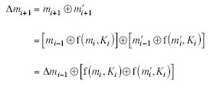
Differential Cryptanalysis Compares Pairs of Encryptions
Differential cryptanalysis is complex
with a known difference in the input
searching for a known difference in output
Notes:
Called Differential Cryptanalysis because the analysis compares differences between two related, encryptions - and looking for known difference in leading to a known difference out.

Slide 38
Differential Cryptanalysis
Have some input difference giving some output difference with probability p
If find instances of some higher probability input / output difference pairs occurring
Can infer subkey that was used in round
Then must iterate process over many rounds

Slide 39
Differential Cryptanalysis
Perform attack by repeatedly encrypting plaintext pairs with known input XOR until obtain desired output XOR
When found
  If intermediate rounds match required XOR have a right pair
  If not then have a wrong pair
Can then deduce keys values for the rounds
  Right pairs suggest same key bits
  Wrong pairs give random values
Larger numbers of rounds makes it more difficult
Attack on full DES requires an effort on the order of 2⁴⁷, requiring 2⁴⁷ chosen plaintexts to be encrypted
Notes:
See [BIHA93] for detailed descriptions. Attack on full DES requires an effort on the order of 2⁴⁷, requiring 2⁴⁷ chosen plaintexts to be encrypted, with a considerable amount of analysis – in practise exhaustive search is still easier, even though up to 2⁵⁵ encryptions are required.

Slide 40
Linear Cryptanalysis
Another recent development
Also a statistical method
Based on finding linear approximations to model the transformation of DES
Can attack DES with 2⁴⁷ known plaintexts, still in practise infeasible
Notes:
Again, this attack uses structure not seen before. This time, it works on single encryptions, collecting stats over many encryptions.

Slide 41
Presentation Topics
DSE advantages & attacks : Sultana Marjan, Sourav Barman

